Slide 1
React Tools
Babel, ESLint, React Developer Tool,Webpack, Hot loading using Webpack

Slide 2
Babel
Babel tranform ES6/ES7/JSX of React to code in ES5 JavaScript, which current browsers can run.
Babel : a small core and a giant plugin architecture for ES6/ES7 with a lot of configuration options.
Babel groups such common plugins into something called presets. (ES2015 , React presets)
Install these packages with npm. (http://babeljs.io/)
npm install babel-core --save
npm install babel-loader --save
npm install babel-preset-react --save
npm install babel-preset-es2015 --save

Slide 3
ESLint
"Linting is used to maintain the code quality across different projects with ESLint in React projects.
It also supports ES6 syntax and JSX so that we can also lint next generation code.“
Use eslint-plugin-react and babel-eslint npm packages to lint ES6 and React code.
// package.json
"scripts": {
"lint": "eslint src"
}
$ npm run lint
npm install eslint --save
npm install babel-eslint --save
npm install eslint-plugin-react –save
/reactjs-by-example/src/Home.js
29:20 error Missing space before opening brace space-before-blocks
x 1 problem (1 error, 0 warnings)

Slide 4

React Dev Tools
React is excellent at improving the developer experience.
react-dev-tools to help in debugging apps.
React developer tools are Chrome and Firefox add-ons, which make debugging React apps fun."

Slide 5
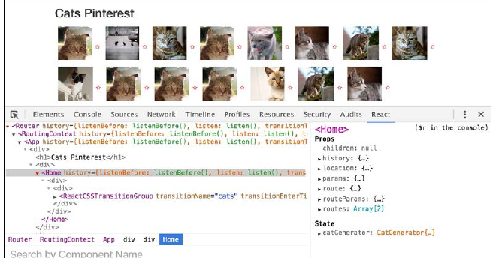
React Dev Tools
Props & state
components

Slide 6
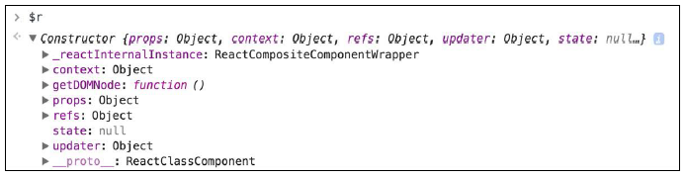
React Dev Tools
Temporary variable—$r.
The selected component from the console is available as $r in the console."

Slide 7
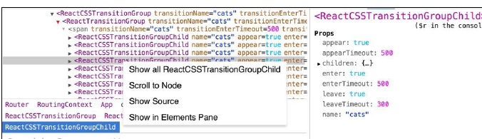
React Dev Tools
"It also allows to scroll to the selected component in the UI to see the actual source code of the component. It can also show all components of a specific type."

Slide 8
Build Tools
Build tools shapes the structure of application.
Capabilities of Build Tool:
• External dependencies as well internal dependencies should be managed
• run compilers/preprocessors
• optimize assets for production
• The development web server, browser reloader, and file watcher should be run by it.
Grunt, Gulp, Browserify , Webpack are popular build tools.

Slide 9
Webpack
"Webpack is a module bundler. It bundles JavaScript with its dependencies into a single package.“
It supports CommonJS module syntax, which is very common in node.js and npm packages.
It is also smart enough to load dependencies in the correct order so that we don't need to worry about ordering explicit and implicit dependencies.“.
“Webpack alone can perform the task of Browserify as well as other build tools such as Grunt and Gulp."

Slide 10
Webpack Configuration
Webpack.config.js : (webpack –config webpack.config.js)
Inform Webpack about the entry point of app
path = require('path');
var webpack = require('webpack');
module.exports = {
// starting point of the application to mount DOM
entry: [ './src/index'] //index.js
};
// src/index.js
render((
<Router history={history}>
<Route path="/" component={App}>
<IndexRoute component={Home}/>
<Route path="/pictures/:id" component={Picture}/>
</Route>
</Router>
), document.getElementById('rootElement'));

Slide 11
Webpack Configuration
Inform Webpack where to put the generated bundled code
from our source. This is done by adding a config for output.“
module.exports = {
entry: ['./src/index'],
output: {
// write the output in dist folder’s bundle.js
path: path.join(__dirname, 'dist'),
filename: 'bundle.js',
publicPath: '/static/'
}
}
"The publicPath specifies the public URL address of the output files, when
referenced in a browser. This is the path that we use in our index.html file, which
will be served by the web server to the users.“<script src="/static/bundle.js"></script>

Slide 12
Webpack Configuration
When you run webpack we get following output:
$ webpack - -config webpack.config.js
Hash: f8496f13702a67943730
Version: webpack 1.12.11
Time: 2690ms
Asset Size Chunks Chunk Names
bundle.js 1.81 MB 0 [emitted] main
[0] multi main 52 bytes {0} [built]
+ 330 hidden modules

Slide 13
Loaders
“Loaders transform JSX, ES6 / ES7 code, and other assets .
Loaders are transformations that are applied to a resource file of our app.
They are functions (running in node.js) that take the source of a resource file as the parameter and return the new source.
Eg: use babel-loader for ES6 and JSX code."

Slide 14
Loaders
module.exports = {
module: {
loaders: [
{ // The test option matches the files with the given regex.
test: / \.jsx?$/,
loader: 'babel-loader',
// this will parse jsx files and transpiles to js from src //folder as we per our below include setting.
query: {
// use babel loader presets for transformation
presets: ['es2015', 'react'],
plugins: ['transform-function-bind']
},
include: path.join(__dirname, 'src')
}]
}
};

Slide 15
Fonts and CSS loading
……
{ test: /\.css$/, loader: "style-loader!css-loader" },
{ test: /\.woff(\d+)?$/, loader: 'url?prefix=font/&limit=5000&mi
metype=application/font-woff' },
{ test: /\.ttf$/, loader: 'file?prefix=font/' },
]
}

Slide 16
Hot Module Replacement (HMRE)
Webpack is Hot Module Replacement (HMR).
Whenever we modify a component and save the file, Webpack will replace the module on the page without reloading the browser and losing component state."

Slide 17
Hot Module Replacement (HMRE)
"To get hot reloading working, we have to use the react-hot-loader package and webpack-dev-server.
The webpack-dev-server package saves us from running Webpack repeatedly for every file change before starting the server.
It will run the app using the config options provided in webpack.config.js.

Slide 18
Hot Module Replacement (HMRE)
// server.js
var webpack = require('webpack');
var WebpackDevServer = require('webpack-dev-server');
var config = require('./webpack.config');
new WebpackDevServer(webpack(config), {
publicPath: config.output.publicPath,
hot: true, // set this for HMR
historyApiFallback: true
}).listen(3000, 'localhost', function (err, result) {
if (err) {
console.log(err);
}
console.log('Listening at localhost:3000');
});

Slide 19
Hot Module Replacement (HMRE)
Configure HMR in webpack.config:
Configure the entry option to include dev server and hot reloading server.“
entry: [
'webpack-dev-server/client?http://localhost:3000',
'webpack/hot/only-dev-server', './src/index'
]

Slide 20
Hot Module Replacement (HMRE)
"Next, inform Webpack to use hot-loader with other loaders
module: {
loaders: [
{ test: /\.jsx?$/,
loader: 'react-hot',
include: path.join(__dirname, 'src')
}
.. .. ..
]
}

Slide 21
Hot Module Replacement (HMRE)
"Finally, the hot module replacement plugin from Webpack has to be included in the plugins section of the config.“
plugins: [
new webpack.HotModuleReplacementPlugin(),
new webpack.NoErrorsPlugin()
]

Slide 22
Final version of webpack.config.js
// webpack.config.js
var path = require('path');
var webpack = require('webpack');
module.exports = {
devtool: 'eval',
entry: [
'webpack-dev-server/client?http://localhost:9000',
'webpack/hot/only-dev-server',
'./src/index'
],
output: {
path: path.join(__dirname, 'dist'),
filename: 'bundle.js',
publicPath: '/static/'
},
plugins: [
new webpack.HotModuleReplacementPlugin(),
new webpack.NoErrorsPlugin()
],
resolve: {
extensions: ['', '.js', '.jsx']
},

Slide 23
Final version of webpack.config.js
module: {
loaders: [
{ test: /\.jsx?$/,
loader: 'react-hot',
include: path.join(__dirname, 'src')
},
{
test: /\.jsx?$/,
loader: 'babel-loader',
query: {
presets: ['es2015', 'react'],
plugins: ['transform-function-bind']
},
include: path.join(__dirname, 'src')
},
{ test: /\.css$/, loader: "style-loader!css-loader" },
{ test: /\.woff(\d+)?$/, loader: 'url?prefix=font/&limit=5000&mi
metype=application/font-woff' },
{ test: /\.ttf$/, loader: 'file?prefix=font/' },
]
}
}

Slide 24
Hot Module Replacement (HMRE)
“Modify package.json to run the server.js script."
// package.json
"scripts": {
"start": "node server.js",
}
$ webpack --config webpack.config.js
$npm start

